Slide 1
Evolution
Evolutionary forces

Slide 2
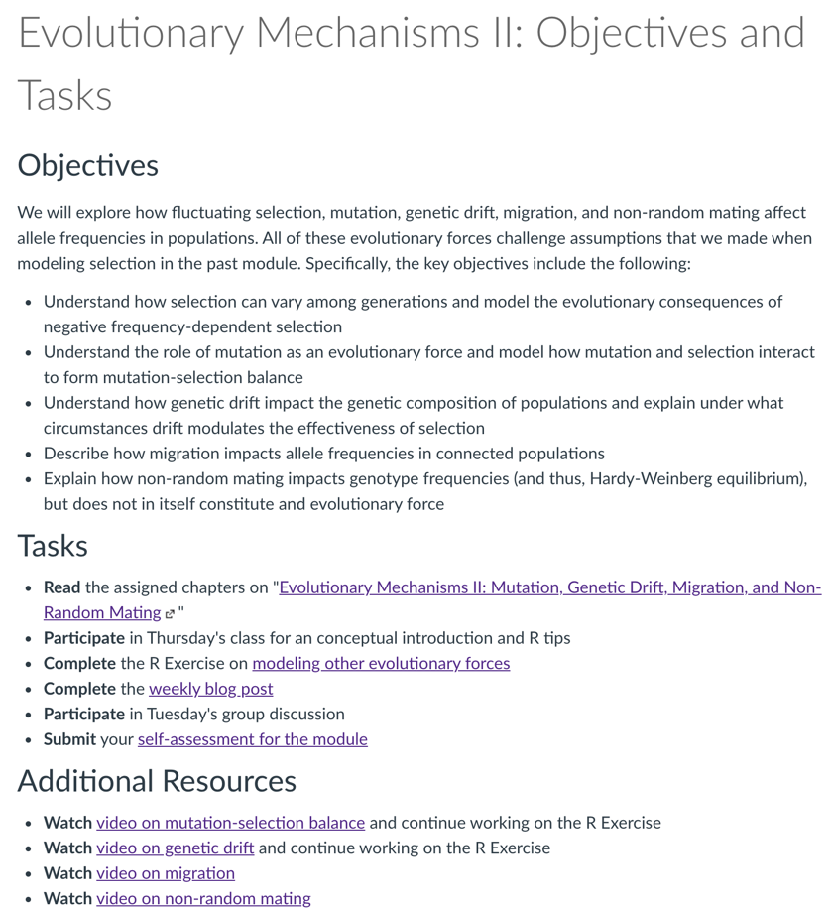
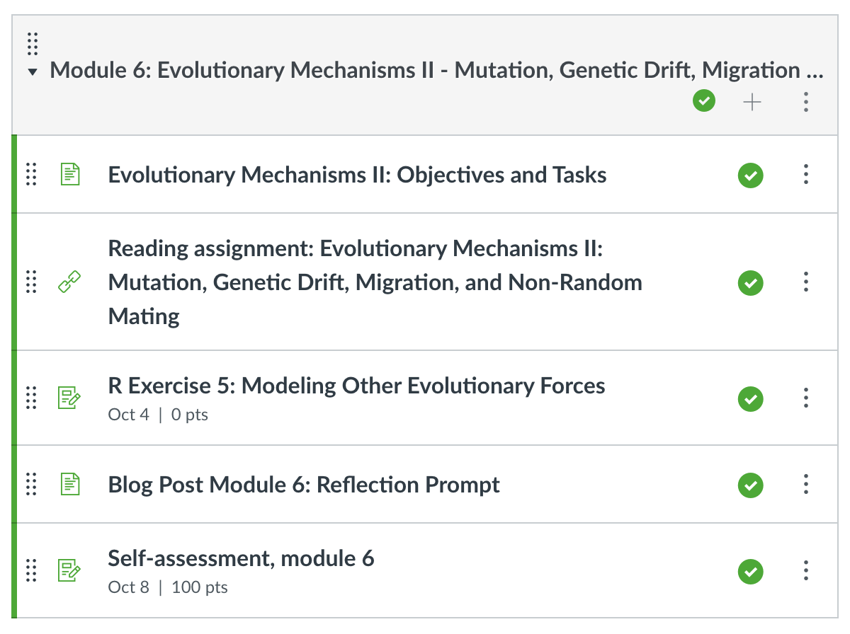

Slide 3
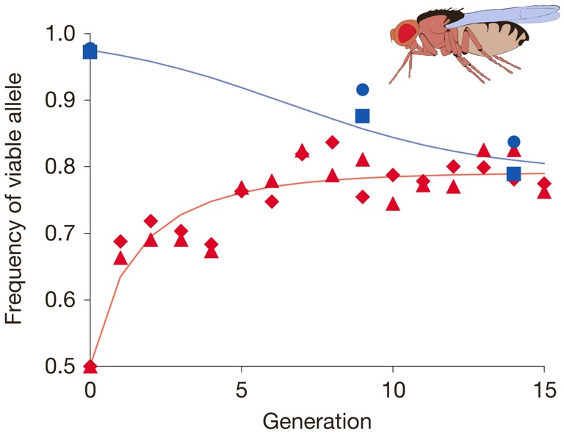
Important conclusions
Selection does not always drive alleles to fixation
Selection can maintain allele frequencies at an intermediate equilibrium
Selection can cause the fixation of alleles that confer lower fitness
Selection models predict outcomes in natural and experimental populations
However,…
…selection is not always stable
…selection interacts with other evolutionary forces

Slide 4
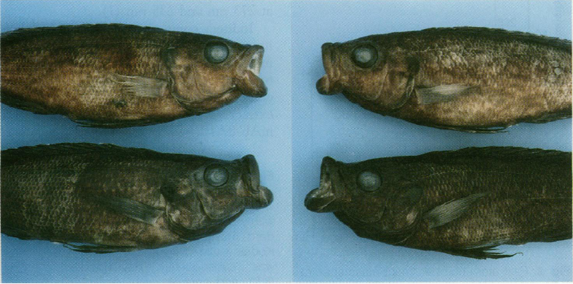
Selection can fluctuate
Environment change
Frequency-dependent selection
Positive
Fitness of genotype increases with its frequency
Rapid fixation of alleles
Negative
Fitness of genotype decreases with its frequency
Section 2 in your R Notebook

Slide 5
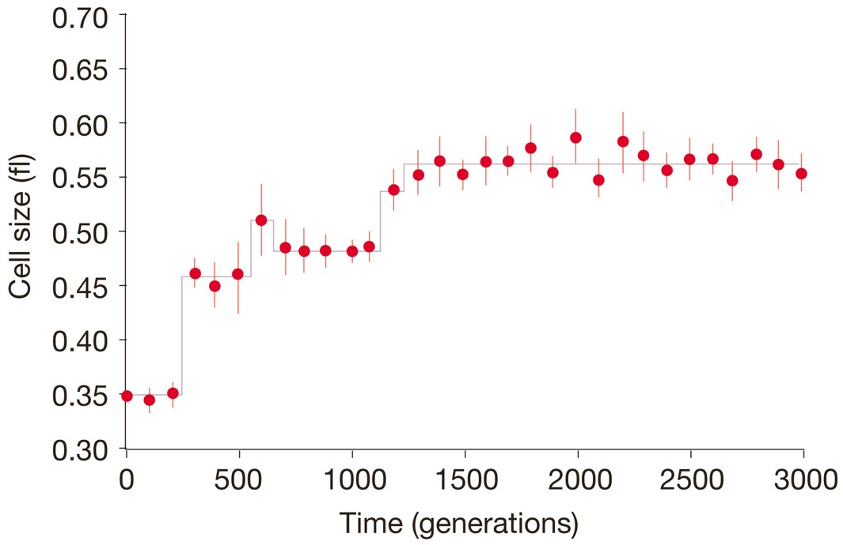
Mutation
Mutation itself is a weak force in evolution
Without mutation, evolution eventually would come to a halt as selection causes fixation of beneficial additive alleles in a populations
Stepwise evolution of cell size reflect an interplay between the occurrence of new mutations and selection

Slide 6
Mutation-selection balance
Most mutations are deleterious, and selection acts to eliminate deleterious alleles.
Deleterious alleles persist because of continuous mutation
When rate of elimination is equal to the rate of mutation, the frequency of an allele is at an equilibrium (the mutation-selection balance)
How do the mutation rate and selection impact the frequency of deleterious alleles?
μ
Mutation
q
Gene pool
With dominant-recessive inheritance, frequency of a deleterious allele at equilibrium:
s
Selection
r <- mutation.selection(p0=1, w=c(1.0,0.5), u=0.001, time=100, show="q")

Slide 7
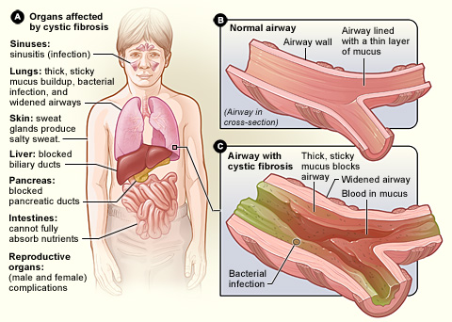
Mutation-selection balance
Cystic fibrosis is a lung disease with high fitness costs caused by a loss-of-function mutation
Frequency in Caucasian population is 0.02
Assuming a selection coefficient of 1, what is the mutation rate?
The actual mutation rate is 6.7*10⁻⁷
How can you explain the discrepancy between your estimate and the actual mutation rate?

Slide 8
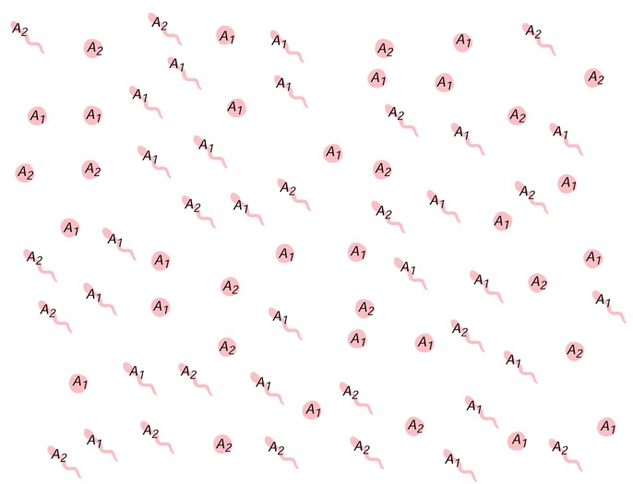
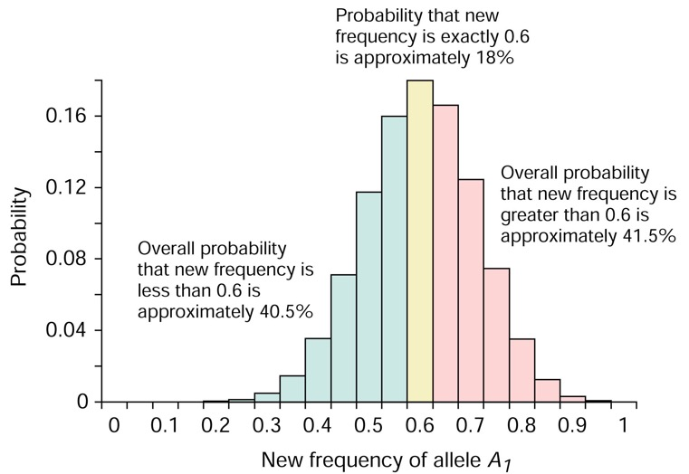
Genetic drift
An evolutionary force generating random changes in allele frequency between generations
Does not lead to adaptation!
Selection is differential reproductive success that happens for a reason, drift is differential reproductive success that just happens!
Population size matters!
What are the long-term consequences of genetic drift?
How does genetic drift interact with selection?

Slide 9
Genetic drift
An evolutionary force generating random changes in allele frequency between generations
Does not lead to adaptation!
Selection is differential reproductive success that happens for a reason, drift is differential reproductive success that just happens!
r <- genetic.drift(p0=0.5, time=100, Ne=100, nrep = 10)
What happens from generation to generation?
What happens to allele frequency in the long run?
What happens to heterozygosity in the long run?

Slide 10
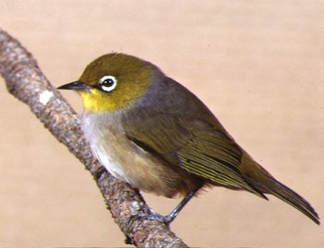
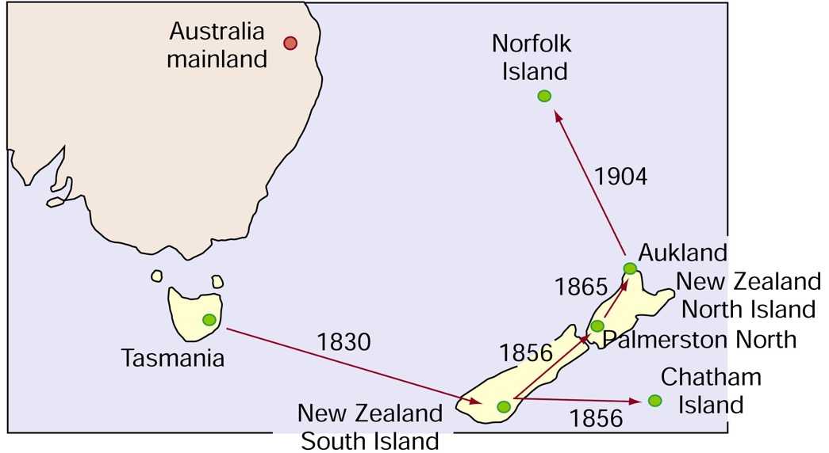
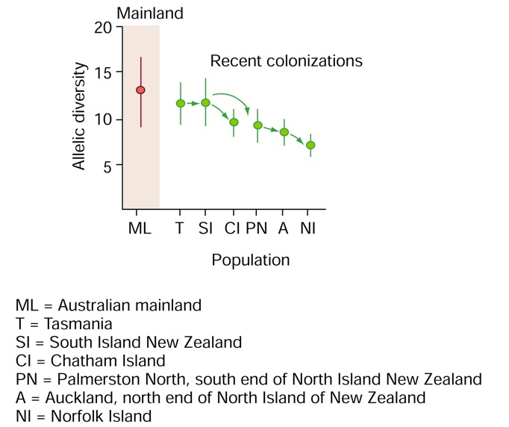
Genetic drift: founder effects
If a population is founded by a small number of individuals, chance alone will cause different allele frequencies in the new population

Slide 11
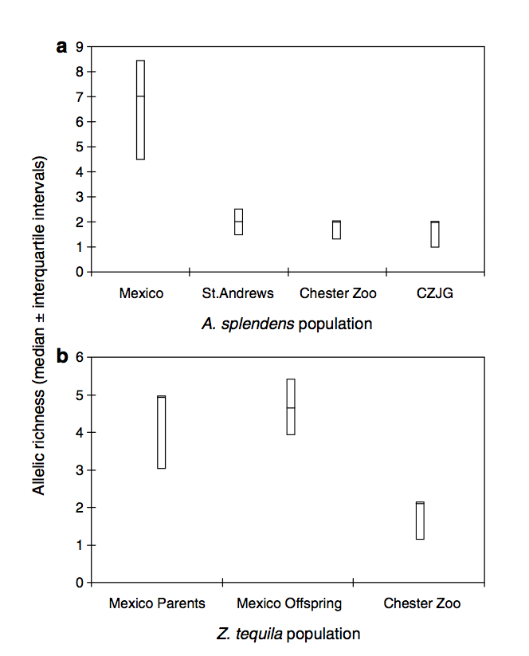
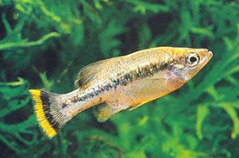
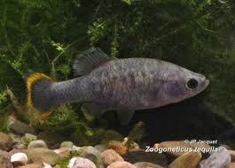
Genetic drift: loss of diversity
In small isolated population, drift can cause a loss of genetic diversity

Slide 12
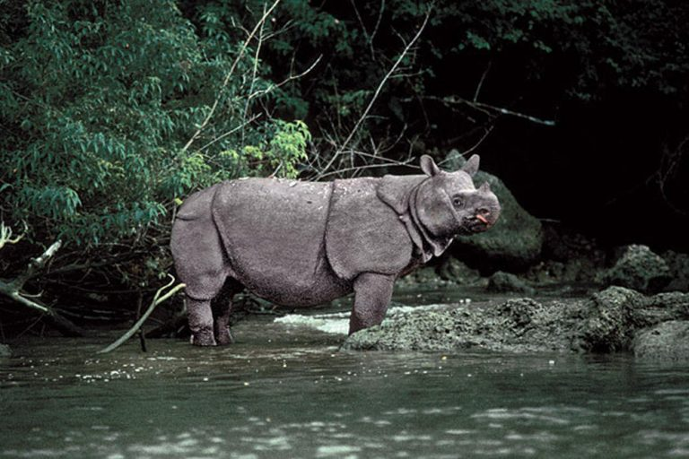
Interactions between mutation, genetic drift, and selection
In natural populations, all mechanisms of evolution occur simultaneously. Assume a new allele comes into a population by mutation, what evolutionary scenarios involving selection and drift can you envision?
r <- drift.selection(p0=0.5, Ne=60, w=c(1,1,1.08), ngen=200, nrep=100)

Slide 13
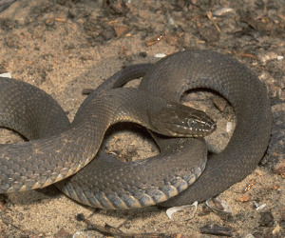
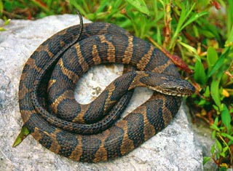
Migration
Movement of alleles between populations with geographic variation
Evolutionary biologists refer to migration as gene flow
Mechanisms vary widely
What are the evolutionary effects of migration?

Slide 14
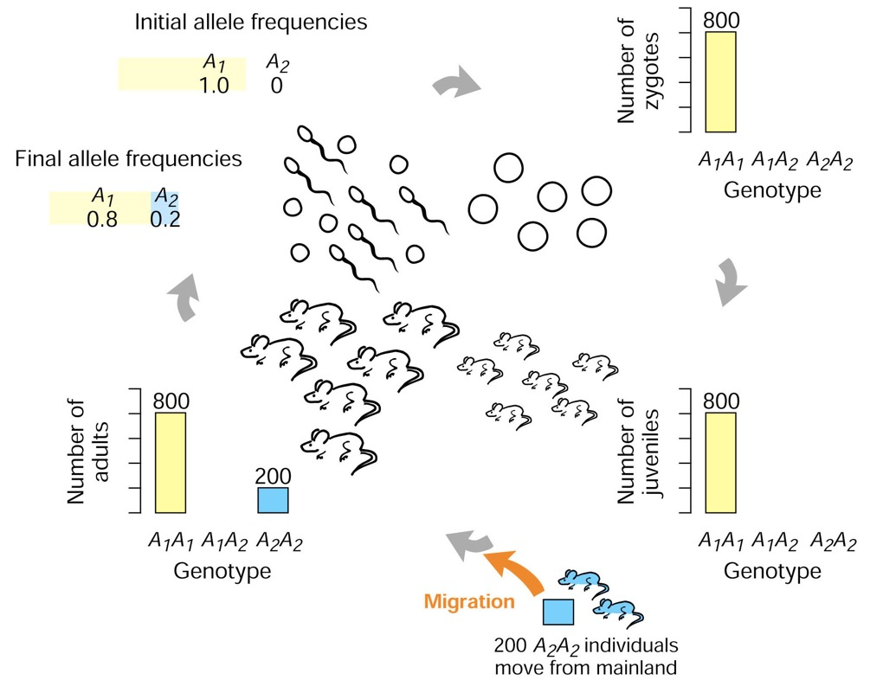
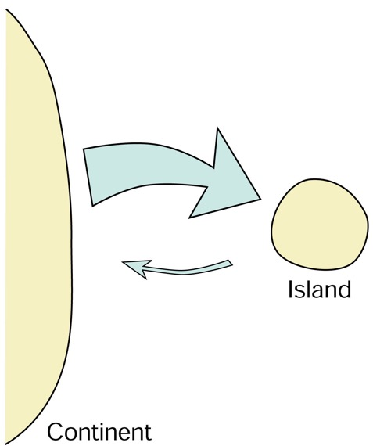
One-island model of migration

Slide 15
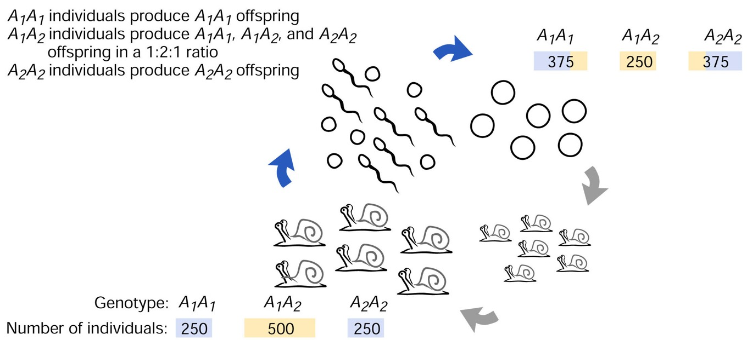
Non-random mating
Does not in itself affect evolution (does not change allele frequencies), but affects HWE
Most common in the form of inbreeding
Inbreeding causes an excess of homozygotes

Slide 16
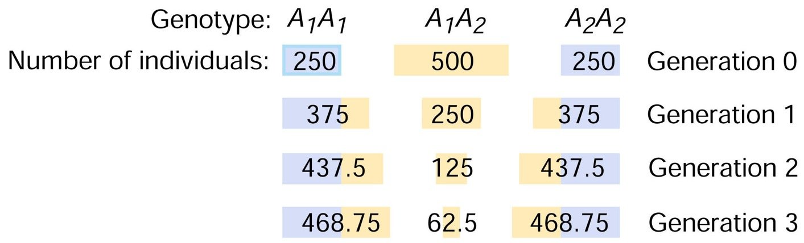
Non-random mating
Prediction of HWE is violated: we cannot predict genotype frequencies by multiplying allele frequencies!

Slide 17
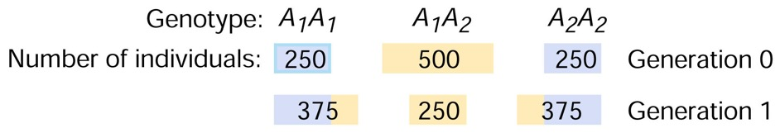
Consequences of inbreeding is predictable
The inbreeding coefficient F describes the probability that are identical by descent
Selfing: F = 0.5
Parent/offspring, siblings: F = 0.25
Half-sibs: F = 0.125
First cousins: F = 0.0625
If F is known, we can calculate genotype frequencies as
f(AA) = p²(1-F)+pF
f(Aa) = 2pq(1-F)
f(aa) = q²(1-F)+qF
If F is known the heterozygosity will be
H_{F}=H₀(1-F)

Slide 18
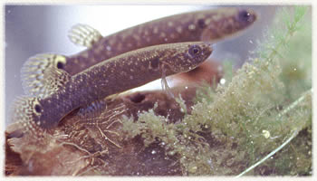
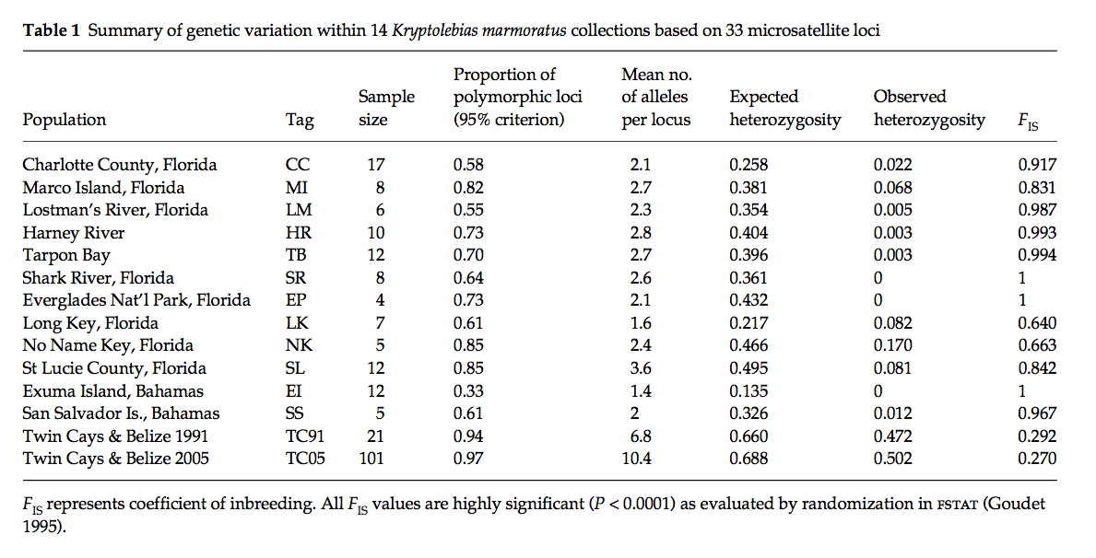
Inbreeding in the wild

Slide 19
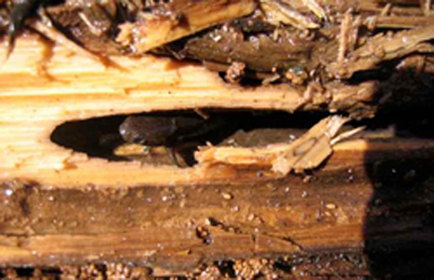
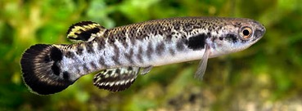
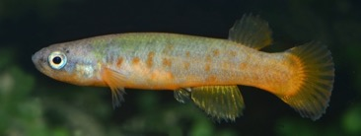
Inbreeding in the wild
Mangrove killifish are monoecious and self-fertilize, with rare outbreeding through the production of males
Inbreeding is also relevant in many plants, organisms with limited dispersal ability, and endangered species
Monoecious individuals
Males
Eggs
Sperm
Offspring

Slide 20
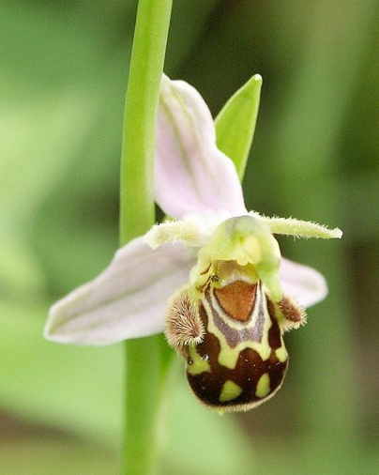
Costs and benefits of inbreeding
Benefits of inbreeding
Inbreeding can facilitate adaptation
Inbreeding can be an exit strategy

Slide 21
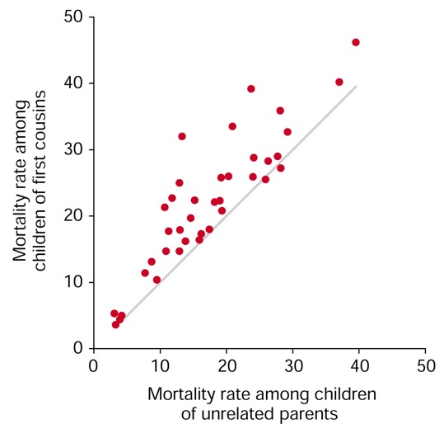
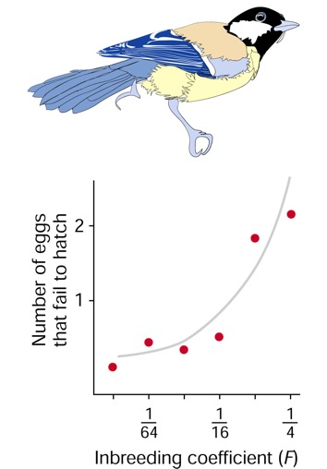
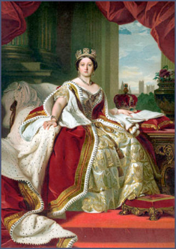
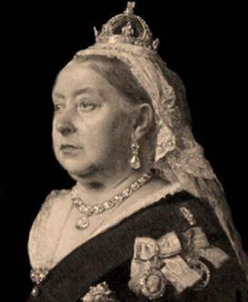
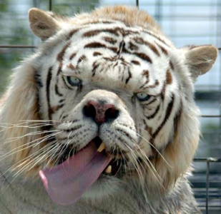

Costs and benefits of inbreeding
Benefits of inbreeding
Inbreeding can facilitate adaptation
Inbreeding can be an exit strategy
Costs of inbreeding
Combination of recessive deleterious alleles (inbreeding depression)
Hemophilia in the royal family

